Slide 1
Comparison of Functional
Programming Languages:
LISP, Scheme, ML, and Haskell

Slide 2
LISP
- Data object types: originally only atoms and lists
- List form: parenthesized collections of sublists
and/or atoms
e.g., (A B (C D) E)
- Originally, LISP was a typeless language
- LISP lists are stored internally as singly-linked
lists
- Lambda notation is used to specify functions:
function definitions, function applications,
and data all have the same form
e.g., If the list (A B C) is interpreted as data it is
a simple list of three atoms, A, B, and C
If it is interpreted as a function application,
it means that the function named A is
applied to the two parameters, B and C
- The first LISP interpreter appeared only as a
demonstration of the universality of the
computational capabilities of the notation

Slide 3
COMMON LISP
- A combination of many of the features of the
popular dialects of LISP around in the early 1980s
- A large and complex language - opposite of Scheme
Includes:
- records
- arrays
- complex numbers
- character strings
- powerful I/O capabilities
- packages with access control
- imperative features like those of Scheme
- iterative control statements
CLOS (Common LISP Object System):
- OOP with LISP

Slide 4
Scheme
- A mid-1970s dialect of LISP, designed to be a
cleaner, more modern, and simpler version than
the contemporary dialects of LISP
- Uses only static scoping
- Functions can be:
- The values of expressions and elements of lists
- Assigned to variables and passed as parameters
- Primitive Functions
1. Arithmetic: +, -, *, /, ABS, SQRT, REMAINDER,
MIN, MAX
e.g., (+ 5 2) yields 7
2. QUOTE - takes one parameter; returns the
parameter without evaluation
- QUOTE can be abbreviated with the
apostrophe prefix operator
e.g., '(A B) is equivalent to (QUOTE (A B))

Slide 5
Scheme (continued)
- QUOTE is required because the Scheme
interpreter, named EVAL, always evaluates
parameters to function applications before
applying the function.
- QUOTE is used to avoid parameter
evaluation when it is not appropriate
3. CAR takes a list parameter; returns the first
element of that list
e.g., (CAR '(A B C)) yields A
(CAR '((A B) C D)) yields (A B)
4. CDR takes a list parameter; returns the list
after removing its first element
e.g., (CDR '(A B C)) yields (B C)
(CDR '((A B) C D)) yields (C D)
5. CONS takes two parameters:
first – an atom or a list
second – a list
returns a new concatenated list
e.g., (CONS 'A '(B C)) returns (A B C)

Slide 6
Scheme (continued)
6. LIST - takes any number of parameters; returns
a list with the parameters as elements
e.g., (LIST A B C D) returns (A B C D)
- Lambda Expressions (for unnamed functions)
- Form is based on λ notation
e.g.,
(LAMBDA (L) (CAR (CAR L)))
L is called a bound variable
- Constructing Named Functions
DEFINE - Two forms:
1. To bind a symbol to an expression
e.g.,
(DEFINE pi 3.141593)
(DEFINE two_pi (* 2 pi))

Slide 7
Scheme (continued)
2. To bind names to lambda expressions
e.g.,
(DEFINE (cube x) (* x x x))
- Example use:
(cube 4)
- Evaluation process:
1. Parameters are evaluated
2. The values of the parameters are
substituted into the function body
3. The function body is evaluated
4. The value of the last expression in the
body is the value of the function
- Examples:
(DEFINE (square x) (* x x))
(DEFINE (hypotenuse side1 side1)
(SQRT (+ (square side1) (square side2)))
)

Slide 8
ML (1990)
Stands for MetaLanguage
- A static-scoped functional language with syntax
that is closer to Pascal than to LISP
- Uses type declarations, but also does type
inferencing to determine the types of undeclared
variables
- It is strongly typed and has no type coercions
- Includes exception handling and a module facility
for implementing abstract data types
- Includes lists and list operations
- The val statement binds a name to a value
(similar to DEFINE in Scheme)
- Function declaration form:
fun function_name (formal_parameters) =
function_body_expression;
e.g., fun cube (x : int) = x * x * x;

Slide 9
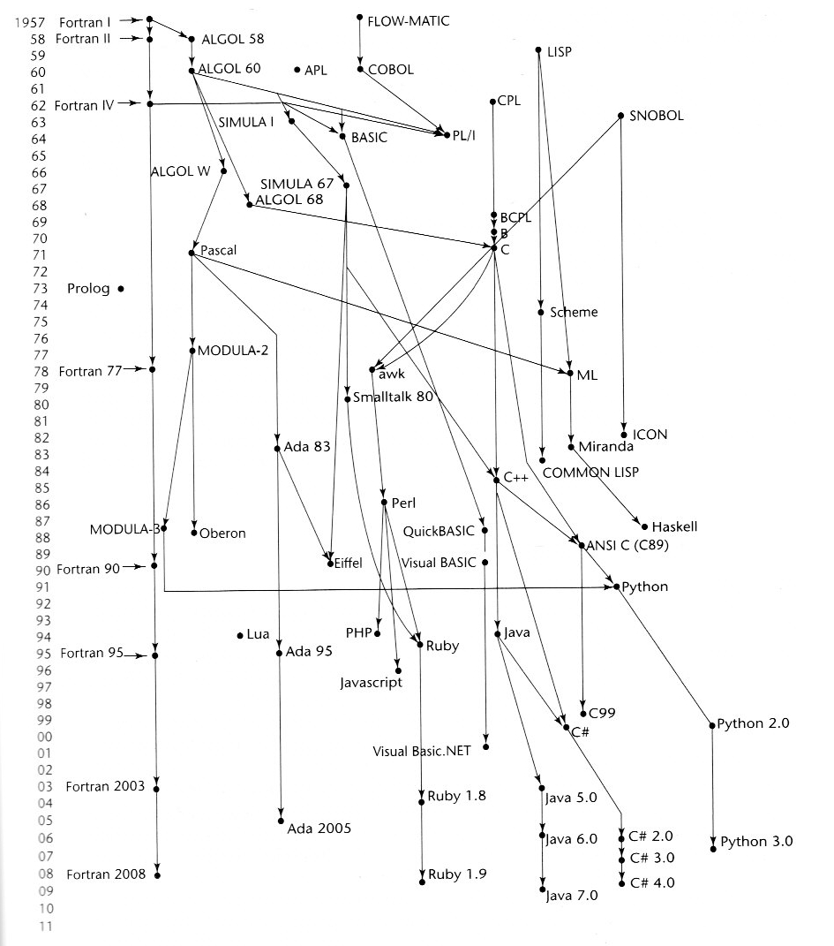

Slide 10
ML
- Built-in types include int, real, boolean, string, and structured data types, as well as user-defined types.
ML provides limited I/O capabilities, due to the research nature of its major users.
ML has three structured data types:
Tuples: (“a”, 1, 2.3)
- Sequence of objects of different types
- ith member accessed as #i
Lists: [a, b, c, d, e]
- Lists are tuples with all elements of the same type
Records: {1=“a”, 2=1, 3=2.3}
- Selectors are named
- Tuples are special cases of records with selectors 1, 2, 3,…

Slide 11
ML
Some operations:
datatype list [a, b, c, d, e]
  hd(x) is head of list or first element
  tl(x) is tail of list or list without first element
  x::y means a list with x as head of list, y as tail
  x@y means join lists x and y
Example ML function to reverse a list:
  fun reverse(L) =
  if L = nil then nil
  else reverse(tl(L)) @ [hd(L)];
How function works:
Either argument is nil or operate on head of L and tail of L.
Apply reverse function recursively to tail of L and add that to the single list consisting of the head of L.

Slide 12
Haskell
- Similar to ML (similar syntax, static scoped, strongly typed, utilizes type inferencing)
- Different from ML (and most other functional
languages) in that it is PURELY functional
(e.g., no variables, no assignment statements,
and no side effects of any kind)
- Most important features:
- Uses lazy evaluation (evaluate no
subexpression until the value is needed)
- Has “list comprehensions,” which allow it to
deal with a range or infinite lists
Examples
1. Fibonacci numbers (illustrates function
definitions with different parameter forms)
fib 0 = 1
fib 1 = 1
fib (n + 2) = fib (n + 1) + fib n

Slide 13
Haskell (continued)
2. Factorial
fact n
| n == 0 = 1
| n > 0 = n * fact (n - 1)
3. List operations
- List notation: Put elements in brackets
e.g., directions = [north, south, east, west]
- Length: #
e.g., #directions is 4
- Arithmetic series with the .. operator
e.g., [2, 4..10] is [2, 4, 6, 8, 10]
- Concatenation is with ++
e.g., [1, 3] ++ [5, 7] results in
[1, 3, 5, 7]
- CONS via the colon operator
e.g., 1:[3, 5, 7] results in [1, 3, 5, 7]

Slide 14
Haskell (continued)
4. List comprehensions
e.g.,
squares = [n * n | n ← [1..20]]
defines a list of the squares of the first 20
positive integers
e.g.,
factors n = [i | i ← [1..n div 2],
n mod i == 0]
computes all the factors of its given
parameter

Slide 15
Haskell (continued)
5. Lazy evaluation
- Infinite lists
e.g.,
positives = [0..]
squares = [n * n | n ← [0..]]
(only compute those that are necessary)
e.g.,
member squares 16
would return True after 5 iterations
then stop
The member function could be written as:
member (m:x) n
| m < n = member x n
| m == n = True
| otherwise = False

Slide 16
Summary
Applications of Functional Languages:
- LISP is used for artificial intelligence
- Knowledge representation
- Machine learning
- Natural language processing
- Modeling of speech and vision
Applications written in Lisp
  The EMACS text editor
  MACSYMA
- Scheme is used to teach introductory
programming at a number of
universities
Comparing Functional and Imperative Languages:
- Imperative Languages:
  - Efficient execution
  - Complex semantics
  - Complex syntax
Functional Languages:
  - Inefficient execution
  - Simple semantics
  - Simple syntax
  Facilitates mathematical function-based
  and recursive programming

